Slide 1

Tuition Exchange 101
Fall 2026

Slide 2

Agenda
Tuition Exchange 101
Who is Eligible?
Terms to Know
Timeline
How to Apply
Common Questions
Tips from TE Parents & TE Central
TE FAQs & Potential Detours

Slide 3



Tuition Exchange by the Numbers
715+
Member
Institutions
7,500+
TE
Scholars
$324M
In Financial
Assistance
*Represents data for 2025-2026 academic year enrolled TE Scholars

Slide 4
What is The Tuition Exchange?
Founded in 1954
A consortium of 715+ colleges/universities offering competitive Tuition Exchange (TE) Scholarships. Not guaranteed!
See participating TE School List at tuitionexchange.org
Schools are no longer required (as of 2020) to equally balance Exports/Imports
Tuition Exchange is different from Tuition Remission!

Slide 5
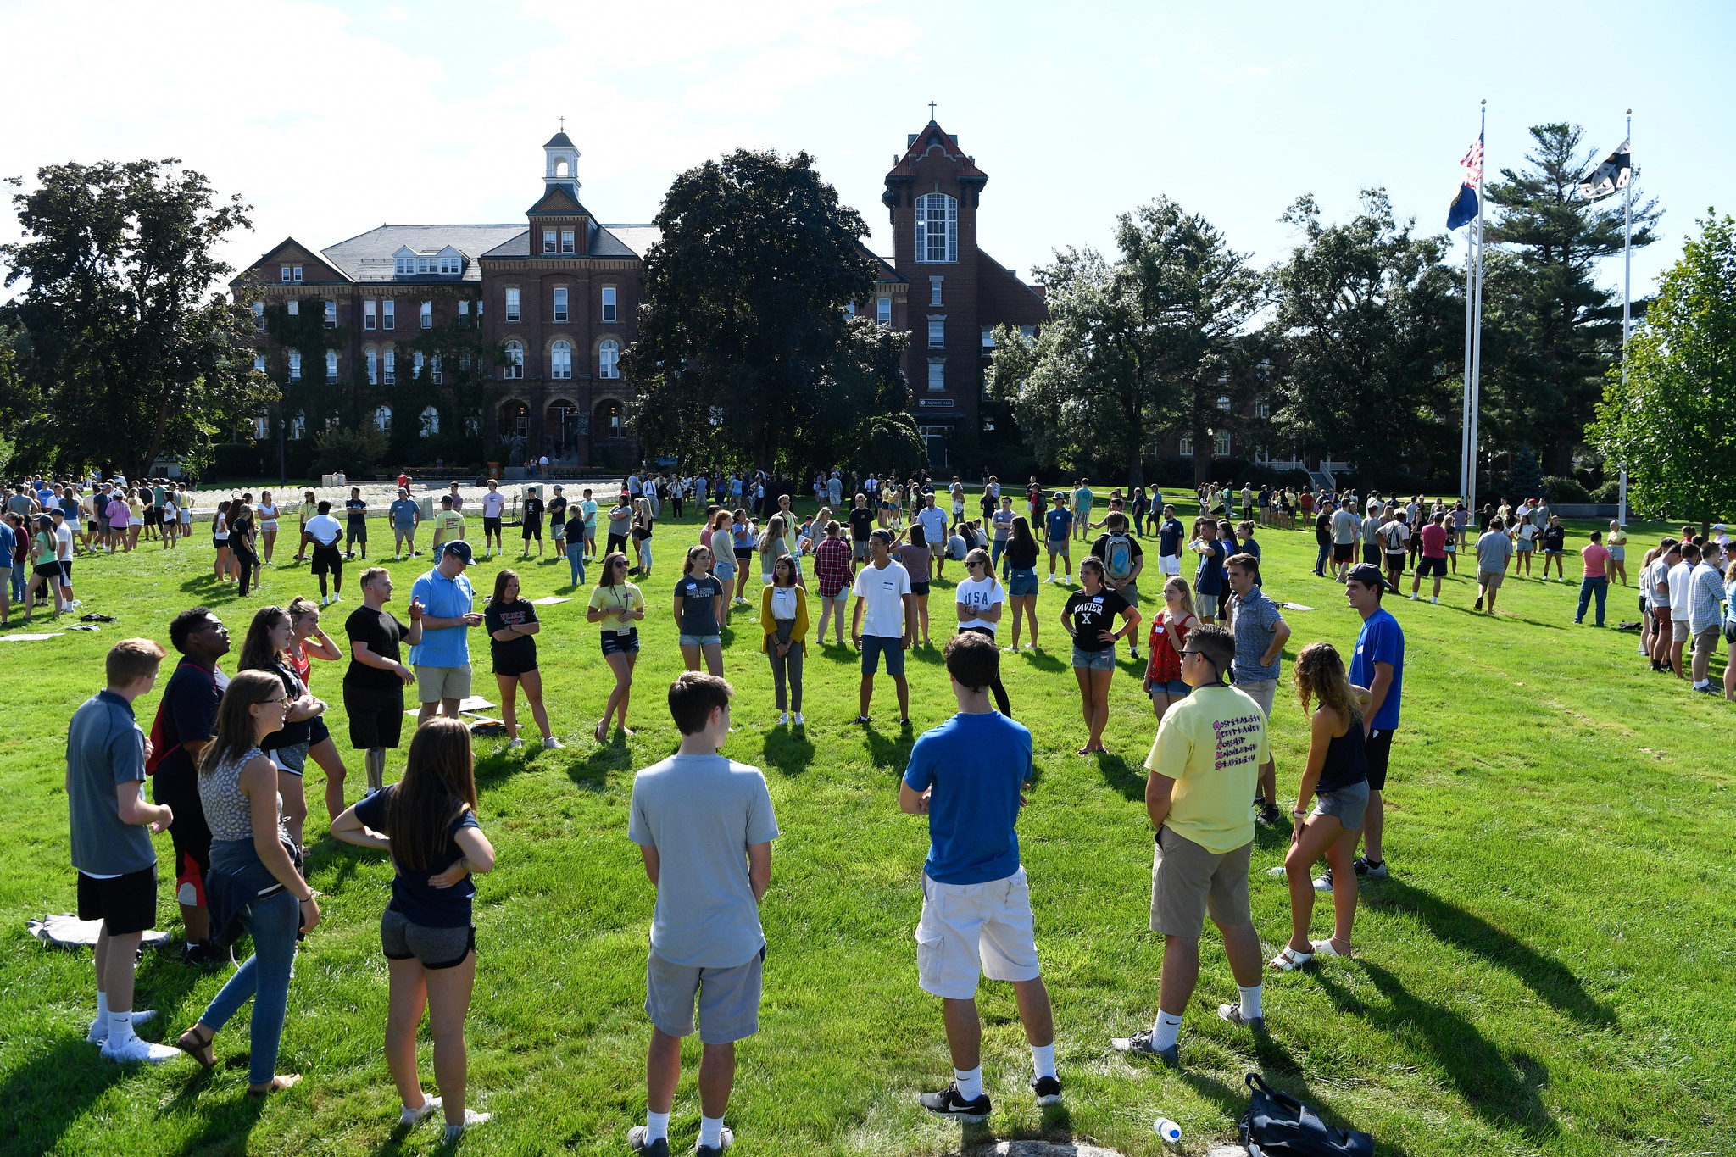
Who is An Eligible TE Export Here?
Enter your respective school’s eligibility guidelines for TE EXPORTS
XXXX
XXXX
XXXX
XXXX
XXXX
XXXX
Exchange programs we participate in: (NOTE-IF YOUR SCHOOL PARTICIPATES IN CIC-TEP and/or fachex, add statement: Students CAN receive consideration for all exchanges by completing one te application)
ADD PHOTO OF YOUR OWN INSTITUTION

Slide 6
Terms to Know
TE Central: Employees that support TE member schools/TELOs
TELO: Tuition Exchange Liaison Officer designated by college to administer TE program. TELO’s support their families!
Export: TE Scholarship applicant emanating from employee’s home institution
Import: A student awarded a TE Scholarship by the host institution
TE Set Rate: TE member schools can offer full tuition scholarship or TE set rate amount $45,000/year for the 2027-2028 year*
FACHEX: Catholic, Jesuit institution Exchange - 26 schools - full tuition scholarship offered to dependent Exports of other FACHEX schools
CIC-TEP: Council for Independent College’s Exchange
* TE Scholarship at public institutions = 50% out-of-state tuition
Meet the Clarks!
Chris Clark works at Potter University. Chris’ daughter, Cassie Clark, is an eligible dependent acc. to Potter University’s TE policy.
Cassie = Export of Potter University
Cassie applies for TE to 15 schools, including Griffin College. Griffin offers Cassie a TE Scholarship and she enrolls there.
Cassie = Import of Griffin College

Slide 7
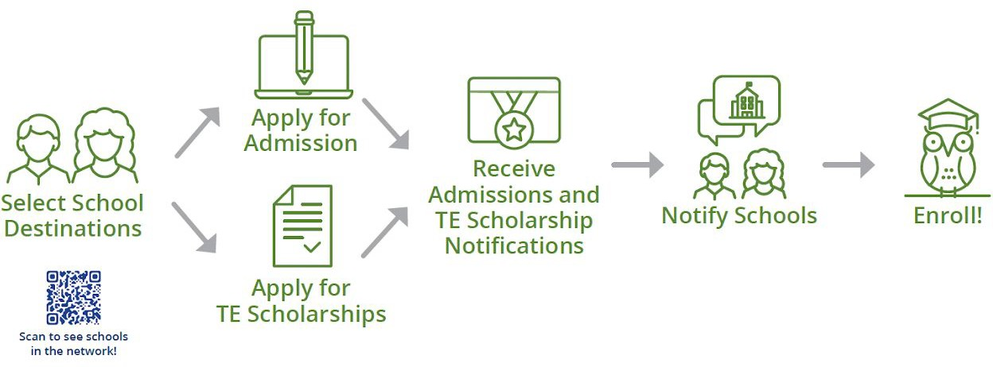
Q: Which comes first, the TE EZ-Application or your admissions applications?

Slide 8
A: It doesn’t matter. . . as long as you submit them by the deadline!

Slide 9
TE Timeline: July 1 is official kickoff!
Aug 1 prior to Senior Year
Fall - Spring Senior Year
Fall - Spring Senior Year
May 1
Senior Year
Juniors & Seniors
Start with TE School Search!
July 1 prior to Senior Year

Slide 10

Where to Start
Review our TE Export policy
  Complete any specific form (s) we require
Begin the school search!
  Connect with TE Colleges
  TE College Search: https://search.tuitionexchange.org/college/search/
    Search on major, location, etc.
Review Scholarship Profile pages
Narrow the list
  List up to 20 schools on the TE EZ-Application
20

Slide 11


The Scholarship Profile Page
Accessed via School List page at tuitionexchange.org or via TE School Search
Direct url:
https://tuitionexchange.org/school-list/
Find the following information:
                TELO contact name/email
                Export & Import TE application deadlines
            Award amount (Full Tuition or TE Set Rate)
            If FAFSA is required
            If living on campus is required
            Whether federal grants, state grants & outside
            scholarships are offset or stacked on top of TE
            Excluded academic programs & class years
            If the school charges a TE administrative fee (most do not, but some do)
            Size of TE applicant pool in prior year
            Number of TE offers made in prior year

Slide 12
How to Apply for TE:
2027-2028
TE EZ-Application opened
July 1, 2026!
1
Step 1
Student creates a TE account using their own email address (an email they’ll keep after high school).
2
Step 2
Student logs in and completes the TE EZ‑Application for the correct award year.*
https://te.tuitionexchange.org/applicantsignin
Note: Students do NOT need to re-apply every year unless they transfer schools or parent transitions to another TE school.
  *Select 2026-2027 year if seeking a Tuition Exchange Scholarship for Fall 2026 / Spring 2027. *Select 2027-2028 year if seeking a Tuition Exchange Scholarship for Fall 2027 / Spring 2028.

Slide 13

Stay Organized!
Chart it…
Cast a wide net (20 spots available
on TE App so dive deep/diversify! )
School | Admissions Deadline | TE Import App Deadline | TE Scholarship Amount | FAFSA/CSS Profile? | TELO
Syracuse University | 12/1/26 | 4/14/27 | TE Set Rate | No | test@test.edu
Tulane University | 12/1/26 | 1/1/27 | $48,279 | Yes (FAFSA) | test2@test.edu
Ithaca College | 12/15/26 | 2/1/27 | Full Tuition | Yes (FAFSA & CSS Profile) | test3@test.edu

Slide 14
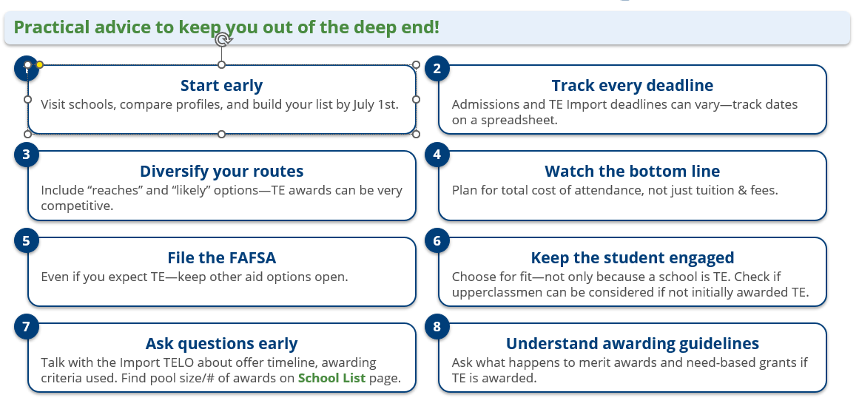
Tips from TE Parents

Slide 15
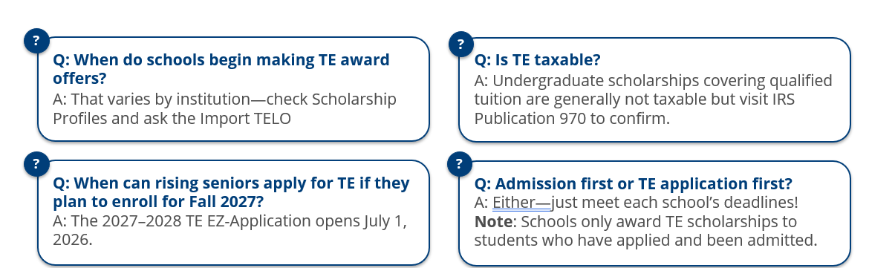

TE FAQs

Slide 16

Tips from TE Central
Key reminders
• Diversify your list and keep an open mind.
• Set expectations early—awards can be competitive.
• Plot multiple paths (use up to 20 slots).
• Check your TE account regularly for updates (students do NOT get auto-emails when schools update their TE status!)
• Prepare to pivot quickly if timelines shift.
• Stay in touch with Export + Import TELOs.
• Help your students stay the course!

Slide 17
Potential Detours
Special situations to know before you apply for TE
Student Decides to Transfer
Log into the TE account and select “Create Transfer Application.”
Student Takes Leave of Absence
Check with the Import TELO. If LOA is >9 months, a new TE EZ‑Application may be required.
Parent Separates from Employment
Confirm when eligibility ends with the Export TELO. Export TELO updates the system which triggers notification to Import TELO.
Student Enrolled FT in Summer School
TE often applies to fall/spring only—check the offer letter and verify with Import TELO.
Five‑year programs
Most awards are up to 8 semesters—ask about extensions if needed.

Slide 18
Questions to Consider if Offered TE
What if a leave of absence is required?
Is study abroad covered?
What if I need more than 8 semesters to graduate?
Are there any associated TE fees?
Does the award amount change each year?
Is there a maximum number of credits per term covered by the award?

Slide 19

Next Steps
Check TE account regularly
for status updates; add and
remove schools as needed
Review TE offers, if received
Select a school & deposit
Notify TELO/admissions counselor of any TE Scholarships you are declining

Slide 20

Questions?
Photo Courtesy of the Buss Family – 5 TE Recipients!

Slide 21


Access Presentation & Contacts
UPLOAD YOUR SLIDE DECK TO GOOGLE DRIVE AND INSERT QR CODE SO THEY CAN CAPTURE YOUR SLIDES
Download slides
Register for a TE Family Webinar
Visit: https://tuitionexchange.org/family-resources/
INSERT YOUR PRIMARY & SECONDARY TELOs CONTACT INFO:
Primary TELO:
Secondary TELO:

Slide 22

Thanks for coming!
Thank you for your time and attention!

